Slide 1
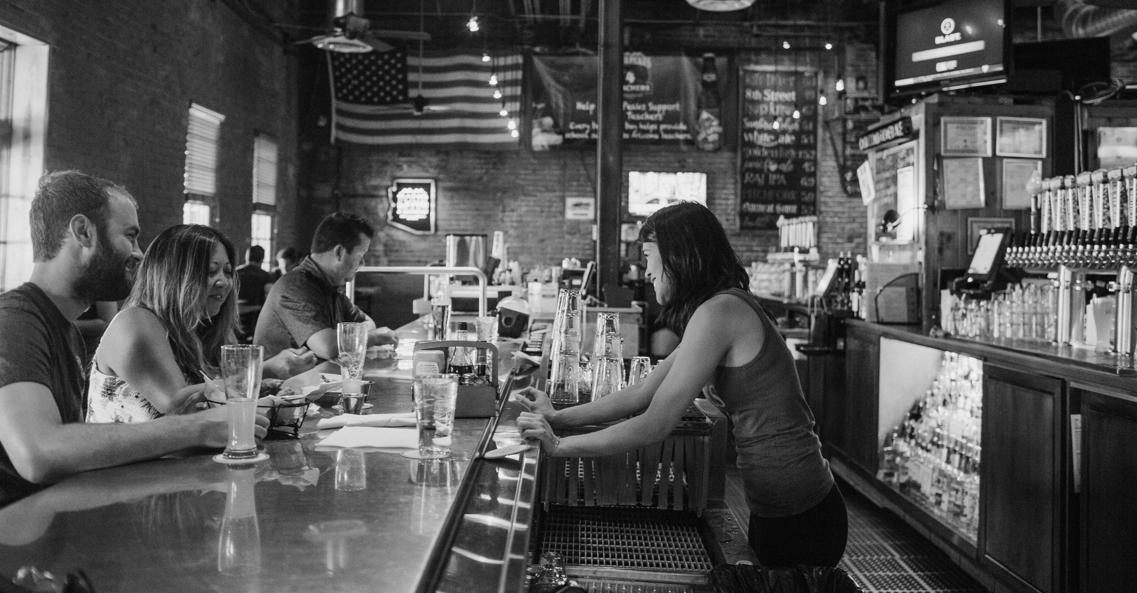
BeerBoard Deck Template
Current

Slide 2
BeerBoard Origin

Slide 3
BeerBoard Was Founded to Help Bar Owners Reduce Loss on Draft Beer
Prior to BeerBoard’s founding in 2005, bar owners were losing thousands of dollars per year, per location due to over-pouring, theft or underperforming draft systems.
BeerBoard’s founder, Mark Young, previously ran a craft-beer focused distributorship servicing all of Upstate NY. Based on firsthand experience with challenges facing the industry, BeerBoard was conceived with the intent to bring more automation and intelligence to the beer supply chain.
For the first time in the industry, BeerBoard provided bar owners and brewers real time, actionable data to drive sales:
Average loss of 24 pints per keg, or 18% of the product
Flow meters installed on each draft line
System tracked draft beer poured vs. cash register rings
Monitoring included keg room temps, line cleaning and more
As a result, BeerBoard was able to help bar owners lower draft beer loss to an average of less than 5% per location, resulting in reclaimed revenue of an average of $22,000 per location annually.
CONFIDENTIAL & PROPRIETARY INFORMATION OF BEERBOARD

Slide 4
Company Growth Driven by Market Need
In the early 2010s, with the explosion of craft beer, retailers were adding tap handles to meet demand. BeerBoard evolved its software platform to allow for synchronizing tap handles with the bar menu. BeerBoard was now offering a broader list of benefits to retailers, including:
Data insights provided fact-based decision making
Instant menu management and communication to consumers
Retailers reduced inventory losses to less than 5%
Increase premium beer sales by 10% or more
As a result, BeerBoard’s client base grew exponentially due to the benefits above, adding national and regional retailers.
CONFIDENTIAL & PROPRIETARY INFORMATION OF BEERBOARD

Slide 5
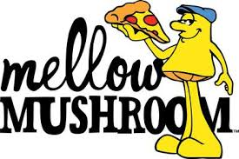
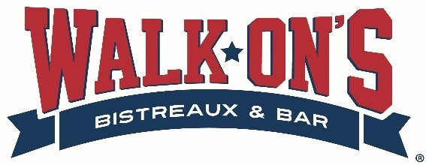
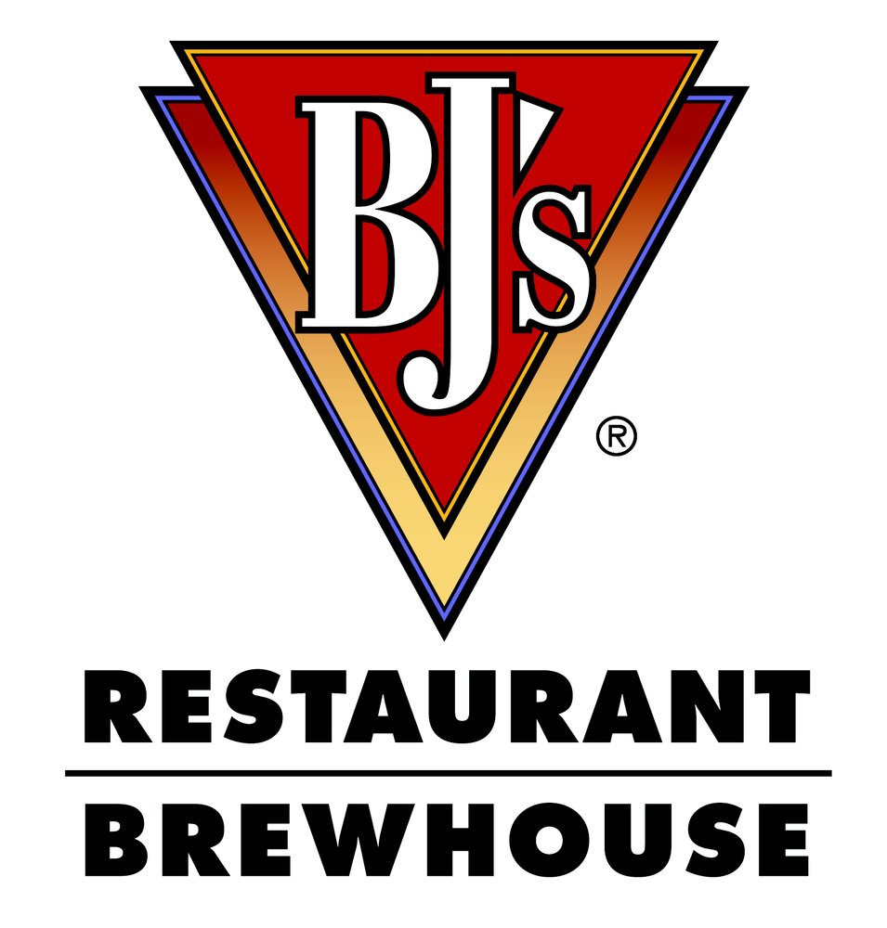
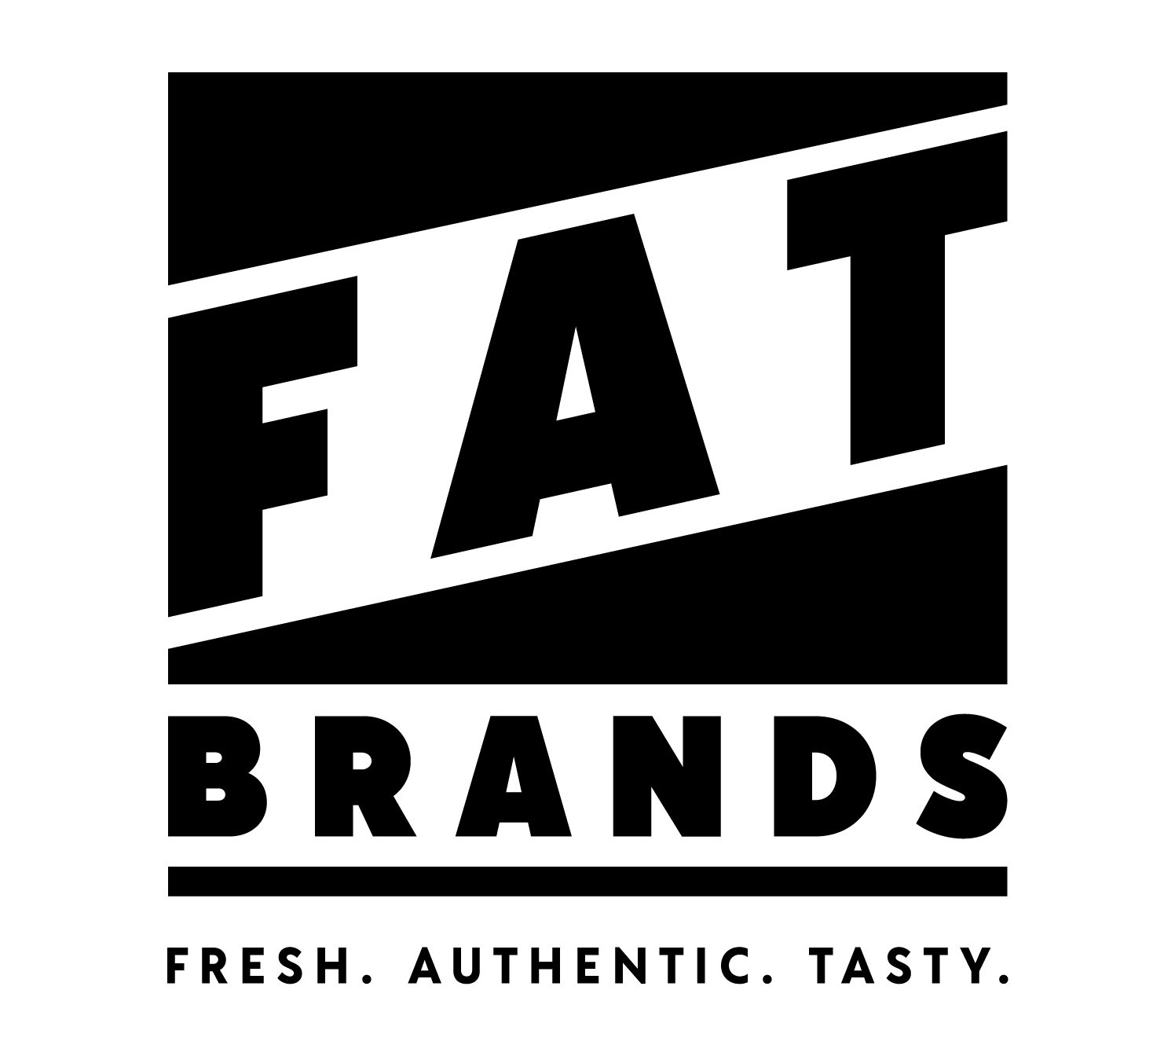
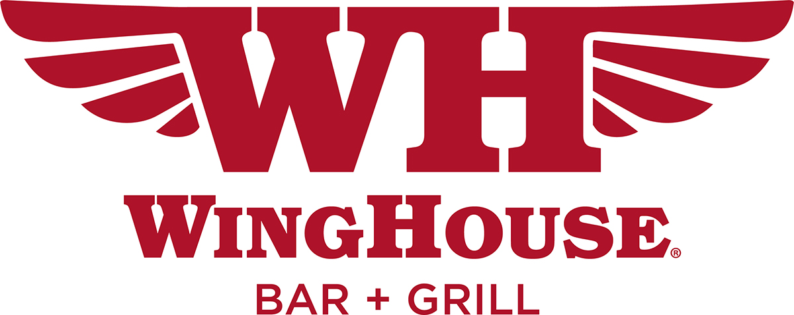
Retail Partner Growth
BeerBoard’s robust client list features high-profile independent groups and major chain operators across North America.
Retail clients include, among others:
CONFIDENTIAL & PROPRIETARY INFORMATION OF BEERBOARD

Slide 6
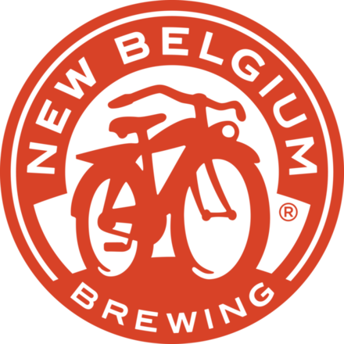
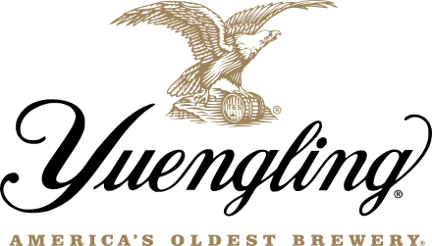
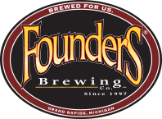
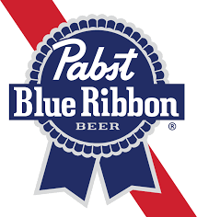
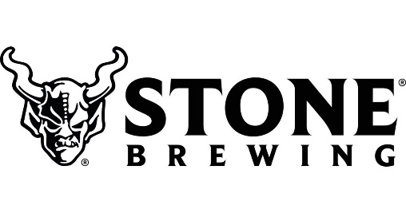
Launched Data Services to Suppliers
Accurate data for the on-premise was difficult to obtain and highly valued by suppliers. In 2018, we launched data services to suppliers which allowed for early detection of emerging brands, styles and retail outlets. Data services, including the features below, will extend to spirits and wine brand owners in 2023:
Complete insights for on-premise account
Historical sales data over defined timeframes
Benchmarking against competitive brand sets
Efficacy of point-of-sale promotions
Custom metrics and brand analytics
As a result, BeerBoard’s supplier client base has grown exponentially to include:
CONFIDENTIAL & PROPRIETARY INFORMATION OF BEERBOARD

Slide 7
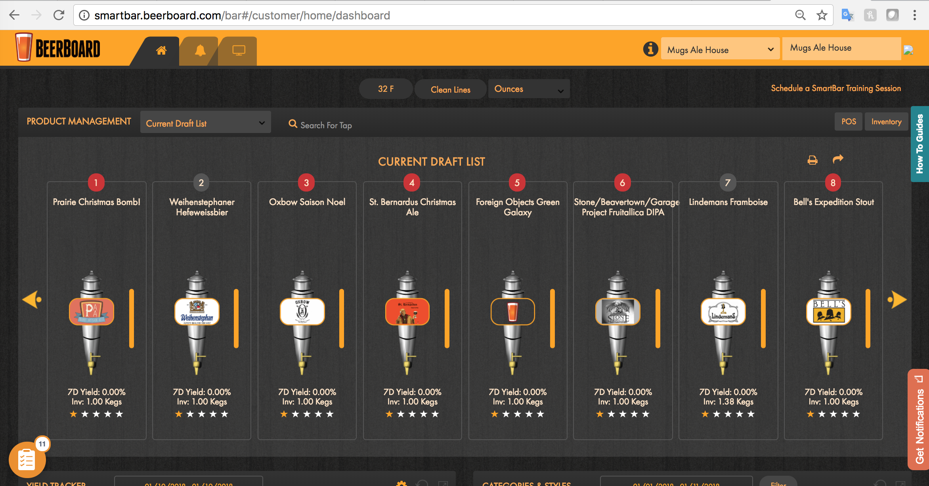
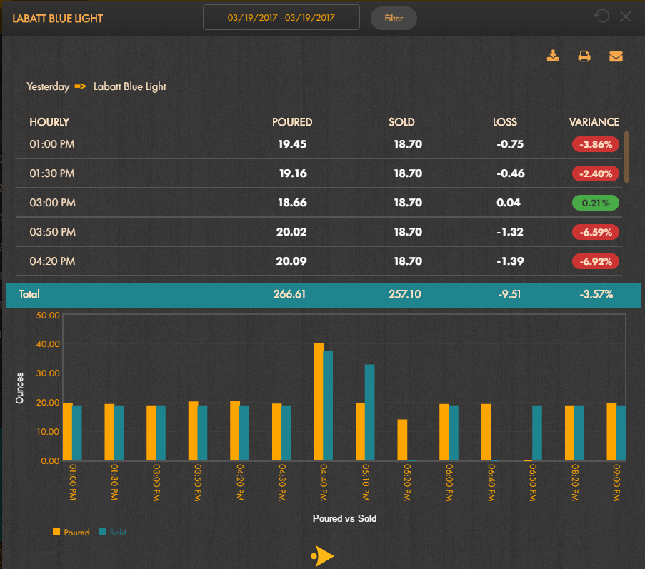
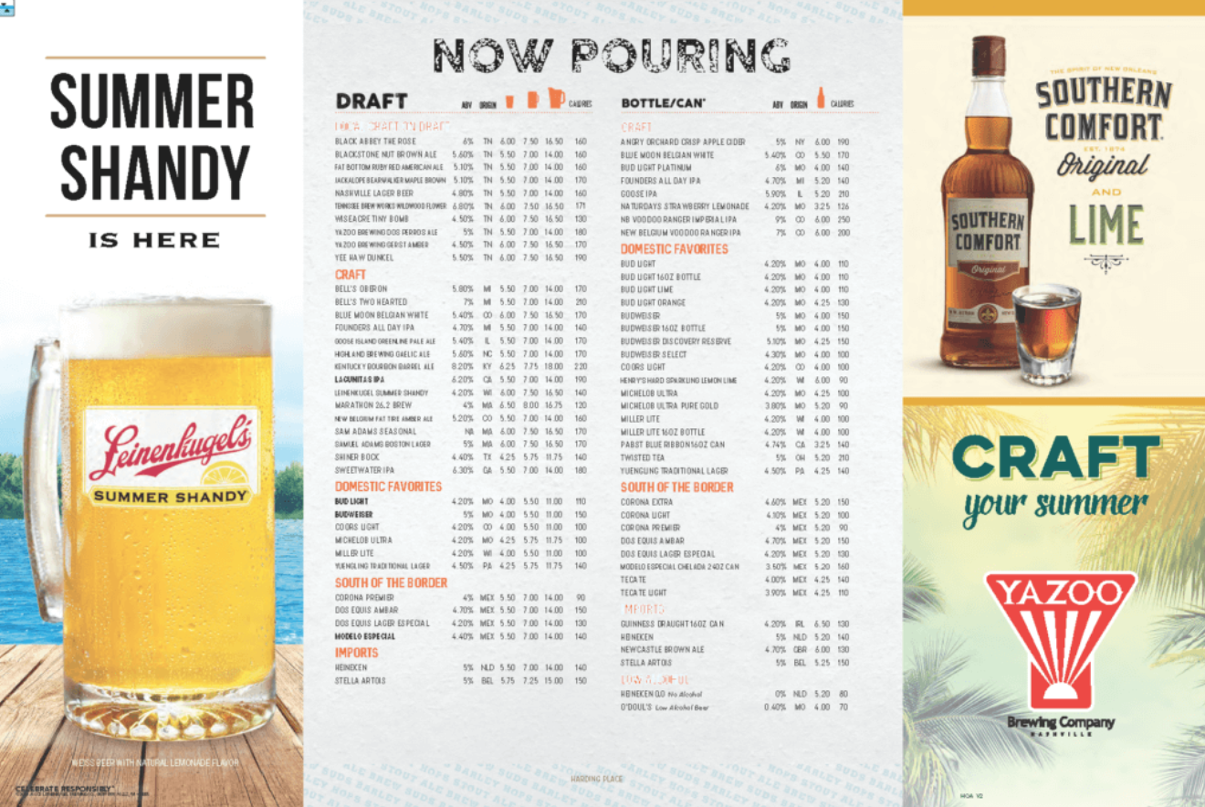
BeerBoard’s Legacy Solutions
Industry-leading alcohol management platform:
Draft Beer data via Flow Meters
Yield Management
BeerBoard TV (displayed beer list)
Print / web-based Menus
CONFIDENTIAL & PROPRIETARY INFORMATION OF BEERBOARD

Slide 8
Covid Impact / Industry Transformation

Slide 9
Industry Shift to Embracing Technology
As a result of Covid, the market was caught flat-footed with the need for a contactless menuing option. BeerBoard quickly developed SmartMenus - a dynamic, digital solution driven from a QR code. This gave retailers the ability to accurately display food and beverage offerings, including video.
In addition, Retailers were in need of the ability to order all alcohol from a single source. Suppliers each had their own ordering policy — not sustainable for a retailer when interacting with 5-10 suppliers. SmartOrders launched in 2021 to consolidate the ordering process for all constituents.
BeerBoard retail partners are positioned to benefit from the digital transformation – integrating data into a retail operations will save time and bring accurate insights. This will empower owners and managers to make fact-based decisions about their business.
CONFIDENTIAL & PROPRIETARY INFORMATION OF BEERBOARD

Slide 10
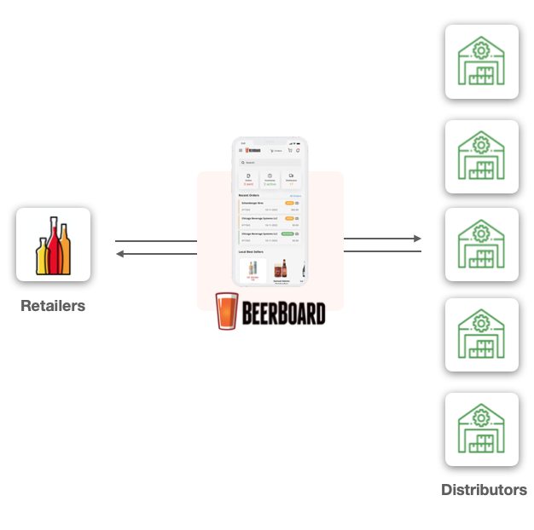
Extended Platform: Full Alcohol Management Connecting Retailers & Distributors
Due to our vast industry experience, BeerBoard recognized how inefficient the supply chain is between retailers and distributors. Retailers traditionally place alcohol orders by phone, text or handwritten notes. Without a consolidated ordering solution, managers at each store will now (or soon) be expected to place every order through five to 10 different distributor websites and manage their products and data in these disconnected systems.
To meet the industry challenge, BeerBoard launched SmartOrders to consolidate all alcohol ordering and inventory interactions into one, unified, agnostic platform.
CONFIDENTIAL & PROPRIETARY INFORMATION OF BEERBOARD

Slide 11
Current BeerBoard Solutions

Slide 12
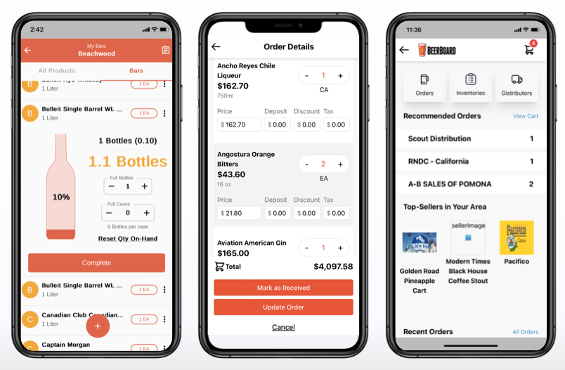
SmartOrders: Automated Ordering, Inventory & Payments
A CENTRALIZED, agnostic solution to manage ALL liquor, beer, wine and packaged goods:
Simplify ordering, inventory & payments
Reduce manual counts and eliminate manual orders to the distributor reps
Automated ordering based on sales and inventory levels to reduce on-hand inventory and improve cash flow
Empower distributor sales team to be consultative partners
CONFIDENTIAL & PROPRIETARY INFORMATION OF BEERBOARD

Slide 13
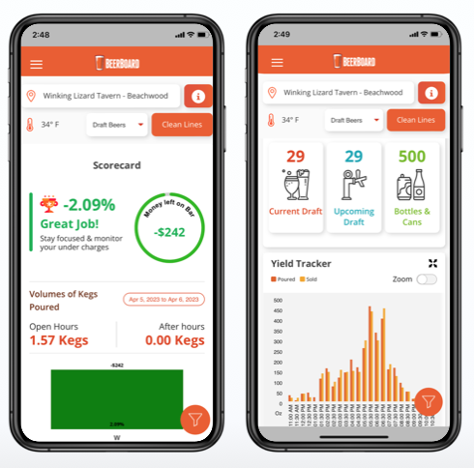
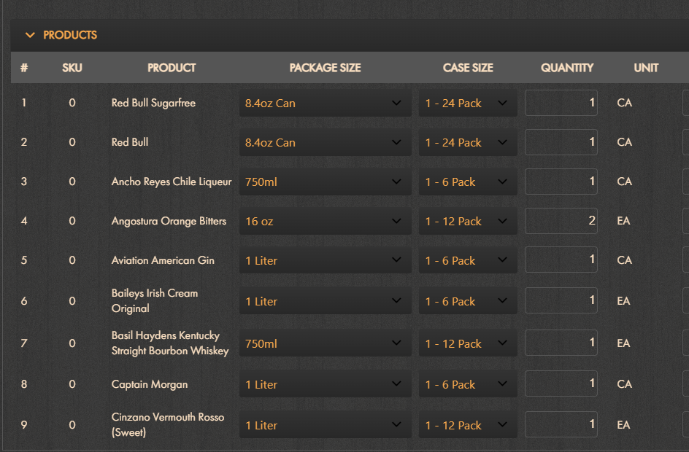
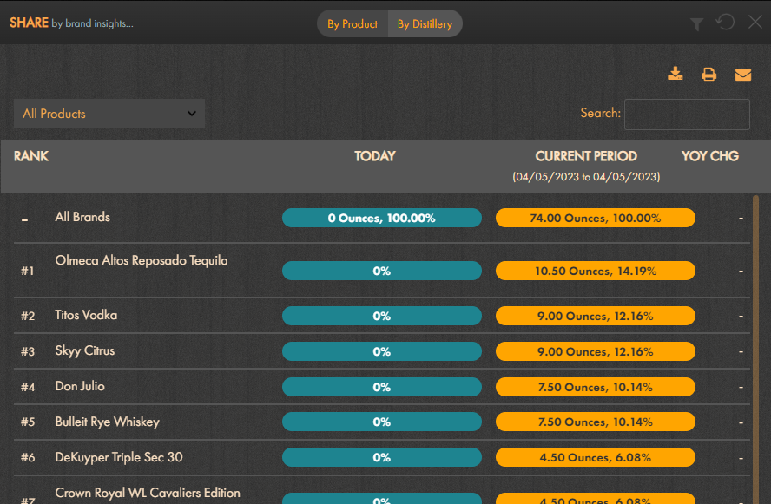
SmartBar: Actionable Data & Insights
Industry-leading alcohol management platform:
Yield Management
POS Integration
PLU Management
Real-time insights for location and brands
Perpetual Inventory Management
Pricing Tiers
Mandate Reporting
CONFIDENTIAL & PROPRIETARY INFORMATION OF BEERBOARD

Slide 14
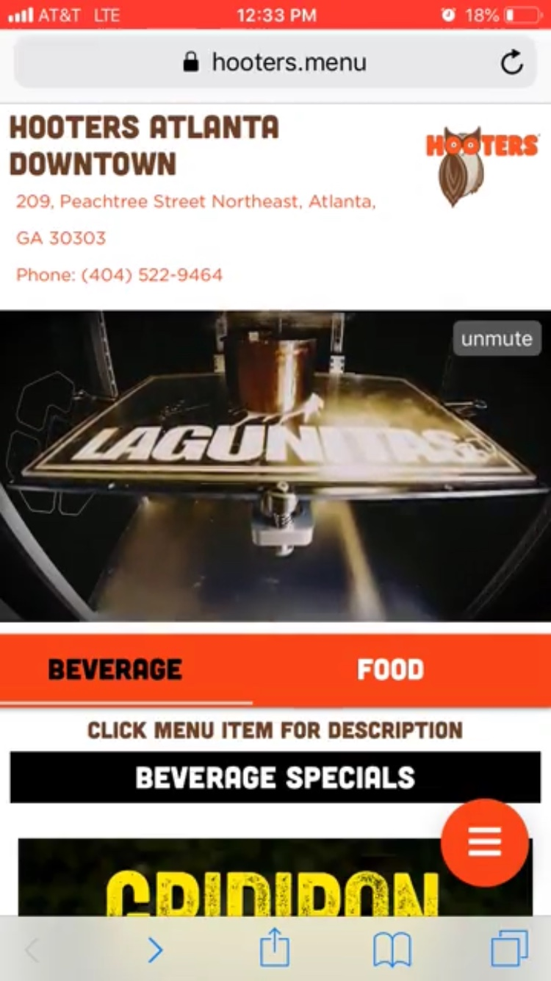
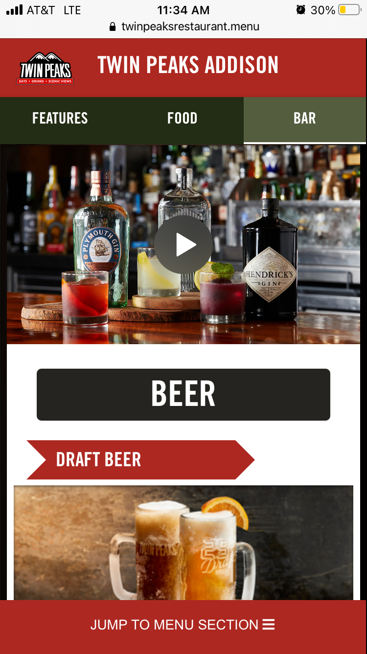
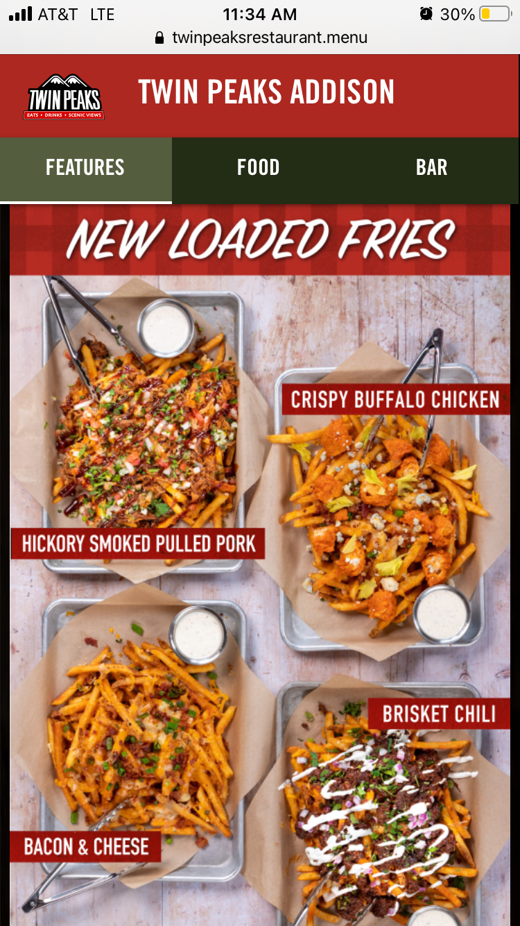
SmartMenus: Real-Time Digital Menus
ONE SOURCE to populate and feature all current food & beverage items:
Contactless menus accessed via QR code
Updates in real-time
Lower cost than printed menus
Dynamic content, including video, for impactful promotions
Flexibility for item changes, prices and LTOs
CONFIDENTIAL & PROPRIETARY INFORMATION OF BEERBOARD

Slide 15
Embrace Technology to Improve Efficiencies

Slide 16
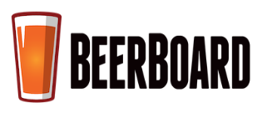
Single Source of Connectivity for the Industry
As an industry technology leader, BeerBoard’s vision is to cement itself as the single point of connectivity between retailers and suppliers.
Our retail partners can leverage BeerBoard’s industry positioning and agnostic platform to untap key operational gains.
This ultimately allows our clients to increase operating margins through actionable insights and more efficient labor to manage alcohol inventory.
Consumers
Retailers
Wine & Spirits
Distributors
Brewers
CONFIDENTIAL & PROPRIETARY INFORMATION OF BEERBOARD

Slide 17
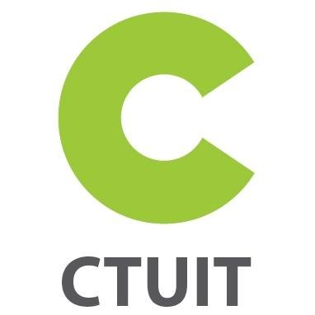
Back-Office Integrations to Drive Efficiency
BeerBoard has developed integrations with the industry’s leading back-office management providers. This helps to make operations more efficient, operating from one unified platform. Equally important, the time savings allows restaurant operators to shift their focus back to providing their guests an exceptional experience.
All alcohol invoices directed to back-office system
Administer accounting, payroll, operations and purchasing
Intuitive technology for data-driven business practices
BeerBoard integrates with the following restaurant management platforms (among others):
CONFIDENTIAL & PROPRIETARY INFORMATION OF BEERBOARD

Slide 18
Adopt Best-In-Class Technology Today
REALIZE BENEFITS — both immediate and long-term:
Automated Recommended Orders (save time)
Invoice / Cost Collection (save time – manual entry/accounting)
Electronic Payments (save time – store/accounting)
AI Generated AvT (losses for all product types – save time on counting)
Profitability and Performance Metrics by Alcohol Category and Brand at store level & regional/market level (price integrity & improved promotional mix to increase profit margins at the bar)
Streamlined process to scale across multiple locations and multiple team members (more scalable process to implements in industry suffering from high turnover)
CONFIDENTIAL & PROPRIETARY INFORMATION OF BEERBOARD

Slide 19
EXTEND YOUR
CAPABILITIES TODAY!
beerboard.com

